Slide 1
Midterm Presentation
FindMyHome Rethinking the Future of Rentals
Naman Diwan
Paurush Batish
Pranav Kapoor
Rutvi Tilala

Slide 2
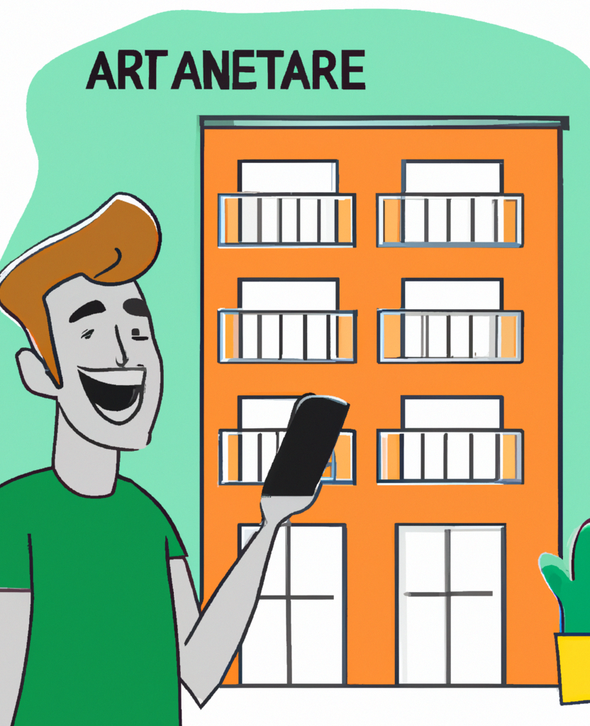
Overview
Problem Statement:
Many individuals searching for apartments face the inconvenience of having to use multiple applications and websites to find, compare, and secure a rental property. This fragmented process often leads to frustration and wasted time.
Solution:
A mobile application that streamlines the apartment rental process, making it easier for users to find, view, and secure rental properties, ultimately simplifying their apartment hunting experience.

Slide 3
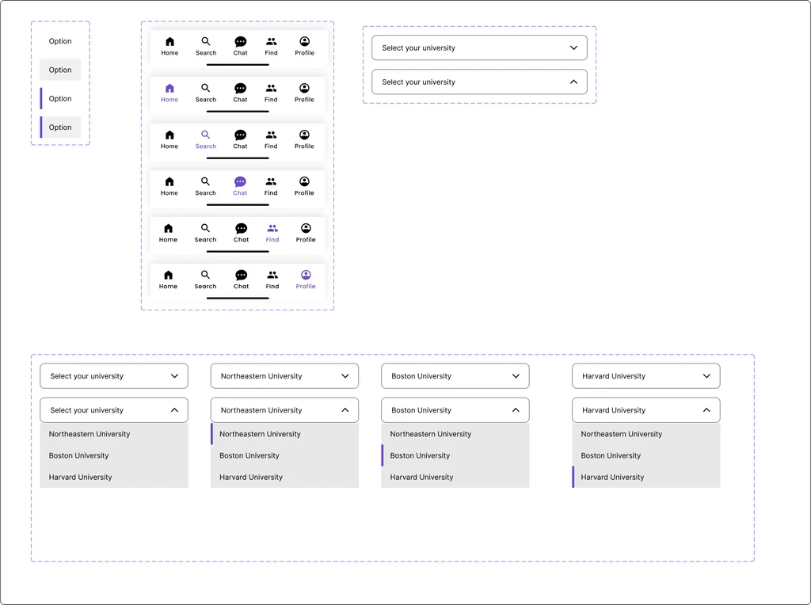
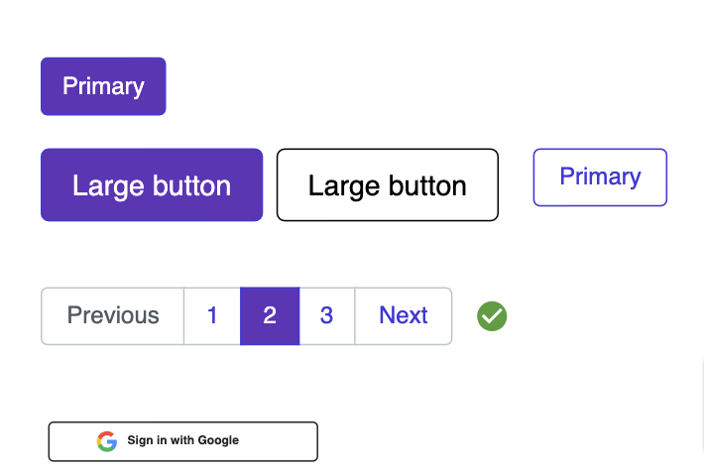
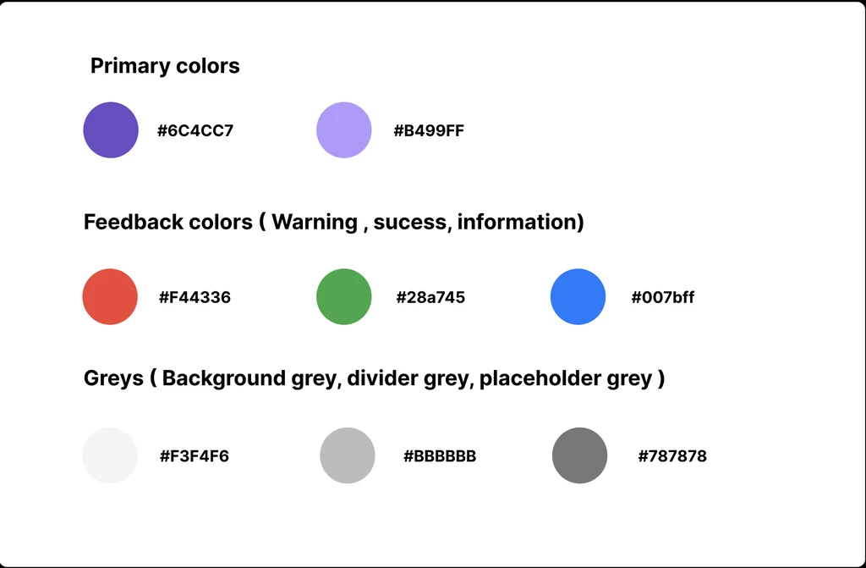
Style Guide

Slide 4




Product Objectives
Curate a diverse and extensive list of housing options, from dormitories to shared apartments and single units.
Introduce a feature that matches students with potential roommates based on preferences and interests.
Provide localized insights like nearby amenities, safety scores, and public transportation options.
Implement a thorough vetting process to ensure all listed properties are legitimate and safe.

Slide 5

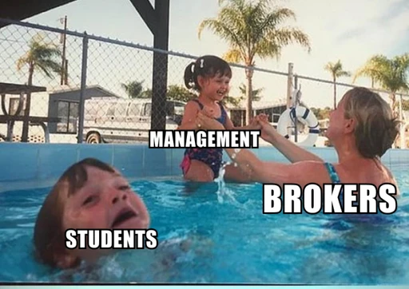
Target Audience
Real Estate Agents: Agents helping students and young professionals find suitable rental properties.
Students: Students searching for off-campus housing or temporary accommodations near their educational institutions.
Young Professionals: Young adults starting their careers and looking for apartments near their workplaces.

Slide 6
User Needs
Comprehensive Property Search: Users want the ability to search for rental properties based on their specific needs, including location, size, rent range, and amenities.
Detailed Property Information: Users expect to access comprehensive property listings with high-quality images, floor plans, descriptions, and a list of amenities.
Saved Search and Shortlisting: Users should be able to save their searches and create shortlists of properties they're interested in.
Application Management: Prospective tenants should be able to submit and manage rental applications directly through the app.
User-Friendly Interface: Users expect an easy-to-navigate interface with intuitive features to make the apartment hunting process seamless.
Notifications and Alerts: Users want to receive notifications about new listings matching their search criteria, appointment reminders, and application status updates.

Slide 7
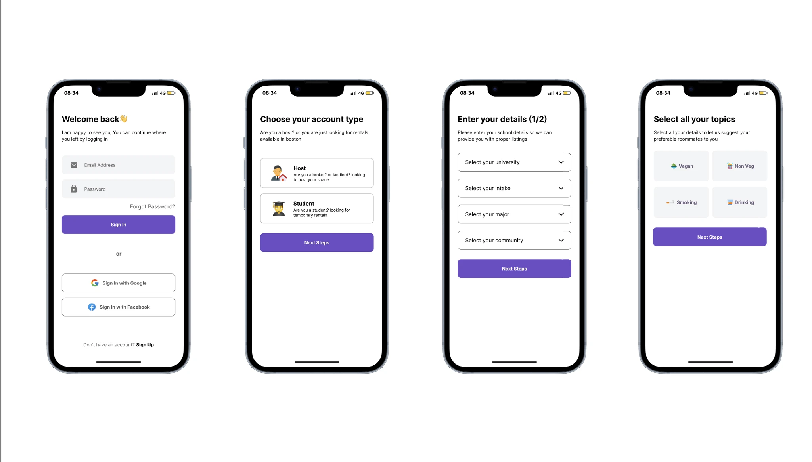
Design Overview

Slide 8
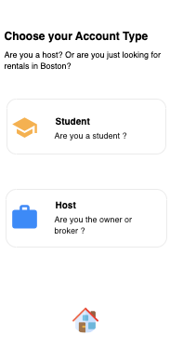
User Onboarding
Onboarding lies at the heart of our platform, ensuring a seamless and positive experience for our young professional renters. As the gateway to our user community, it plays a pivotal role in simplifying the rental process and fostering meaningful connections.
Empowering Young Professionals: Encourage young professionals to create detailed profiles, enabling them to showcase their preferences, budgets, and lifestyle choices. This personalized approach ensures that they find accommodations tailored to their needs.
Efficient Roommate Matching: Our chat option facilitates effortless roommate finding. By understanding users' preferences and habits, we streamline the process of connecting compatible roommates. Onboarding guides users on how to effectively utilize this feature, encouraging them to find like-minded individuals to share their living spaces.
Effortless Listing Management for Brokers: Brokers can effortlessly list their properties, showcase amenities, and efficiently manage inquiries, fostering a proactive and responsive environment.
Enhancing Communication: The onboarding process highlights our chat feature, emphasizing its importance in connecting prospective roommates. Effective communication is key to successful shared living arrangements, and our platform ensures that renters can easily communicate, discuss preferences, and make informed decisions.

Slide 9
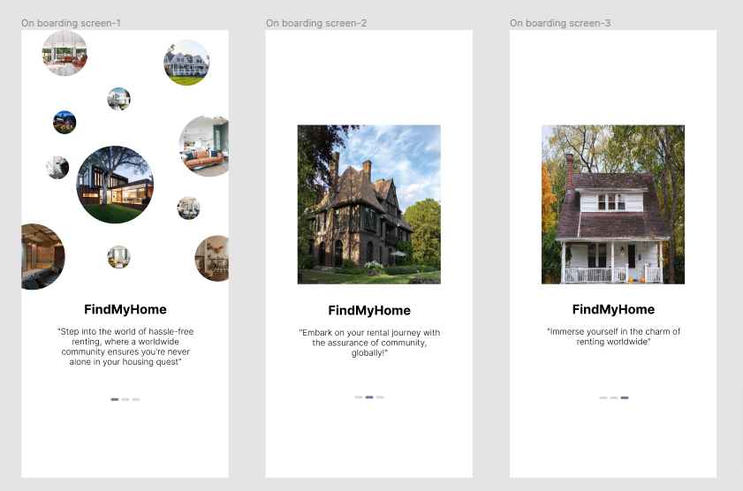
Student Onboarding

Slide 10
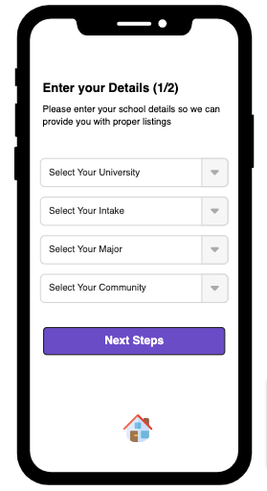
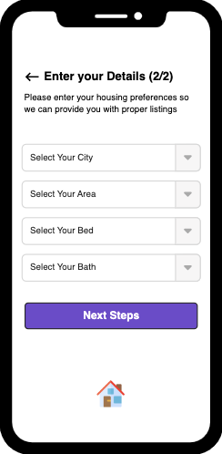
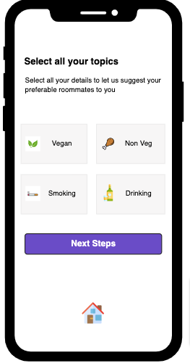
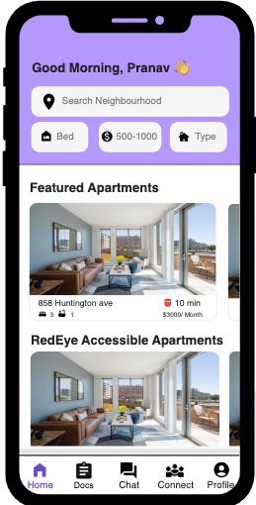
Student Onboarding

Slide 11
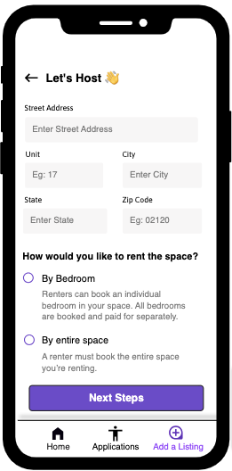
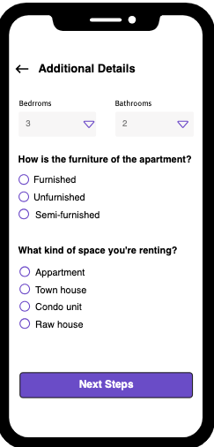
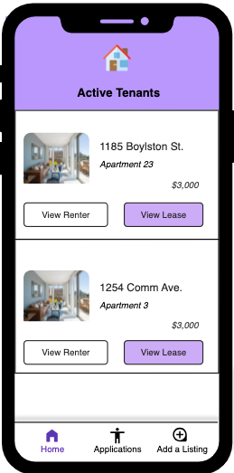
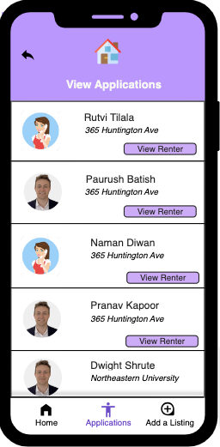
Broker Onboarding

Slide 12
Middleweight use case
Actor: Young Professional (Rita and Mark) Use Case Overview: Renter searching for a shared apartment and utilizing the platform's features to find compatible roommates. Subject Area: Rental Accommodation Services Trigger: Rita and Mark initiate a search for a shared apartment on the platform. Precondition: Rita and Mark have registered accounts on the platform. Basic Flow: Rita and Mark log into their accounts. They enter their preferences, including budget, location, and amenities. The platform displays a list of compatible shared apartments. Rita and Mark initiate a conversation using the chat feature to discuss habits and preferences. After mutual agreement, they finalize the arrangement and confirm the shared apartment. | Alternate Flow A: If Rita and Mark do not find suitable options in the initial search results, they refine their preferences and initiate a new search. Postcondition: After completion, Rita and Mark have secured a shared apartment, updated profiles, and received confirmation notifications. The apartment is marked as rented, chat history is stored, and the platform's database accurately reflects the updated availability.

Slide 13
Middleweight use case
Actor: Real Estate Agent (Sarah) Use Case Overview: real estate agent listing multiple properties on the platform and efficiently managing inquiries and communications with potential tenants. Subject Area: Property Management and Listings Trigger: Sarah, the real estate agent, logs into her account to add new properties to the platform. Precondition 1: Sarah has an active account and valid property details ready for listing. Precondition 2: The platform's database is accessible and capable of handling new property listings. Basic Flow: -Sarah logs into her account and accesses the platform's listing management section. -She enters detailed property information, including location, amenities, rental price, and high-quality images. -Potential tenants view the property details and send inquiries via the platform's messaging system. -Sarah manages multiple inquiries simultaneously, ensuring efficient communication with interested tenants. | Alternate Flow A: If a property receives overwhelming interest, Sarah can schedule group viewings or virtual tours, optimizing the property showcasing process. Postcondition: The properties are successfully listed, inquiries are managed efficiently, and Sarah has responded to potential tenants. Property listings are live, and Sarah's account reflects updated interactions, ensuring a streamlined rental process.

Slide 14
Heavy-weight use case
Actor: Real Estate Agency Administrator Use Case Overview: a real estate agency managing a diverse portfolio of rental properties through the platform, streamlining complex property management tasks, ensuring tenant satisfaction, and optimizing the overall leasing process. Subject Area: Real Estate Property Management Trigger: Introduction of new properties into the agency's portfolio or when properties undergo changes such as renovations or lease renewals. Precondition: The real estate agency has an active account and a diverse portfolio of rental properties. Basic Flow: Administrator logs in and manages property listings. Tenant screening includes background checks and rental references. And lease agreements are generated and securely stored for compliance. Tenants report issues via the platform's ticketing system. Agency coordinates prompt responses and resolutions for maintenance requests. Real-time financial tracking tools monitor rent payments and expenses. Transparent communication is maintained between managers, landlords, and tenants. | Alternate Flow A: In the event of unexpected maintenance emergencies, the platform triggers instant notifications to property managers, enabling rapid response and minimizing disruptions for tenants. Alternate Flow B: If a lease renewal is due, the platform automates notifications to both tenants and landlords, reminding them of upcoming renewals, facilitating seamless agreement updates, and ensuring a smooth transition between rental periods. Postcondition: Property listings are updated, maintenance requests resolved promptly, legal documents securely stored, ensuring compliance, transparent communication maintained, and tenant feedback utilized for continuous improvement, guaranteeing efficient property management and tenant satisfaction.

Slide 15
Heavy-weight use case
Actor:University Housing Department Administrator Use Case Overview: University housing department managing the allocation of student accommodations, optimizing room assignments, matching compatible roommates, handling special accommodation requests, and ensuring a positive and inclusive living experience for all Subject Area: Student Housing Allocation and Roommate Matching Trigger: Beginning of an academic year or when new students are admitted. Precondition:The university housing department has access to verified student profiles, including special accommodation requests. Basic Flow: University housing administrator logs into the housing allocation system. Student profiles with preferences and special needs are imported. Platform algorithms process data (accessibility, medical needs, habits) Optimized room assignments are made based on various factors. Compatible roommates are matched (shared interests, study habits). Special accommodations (e.g., wheelchair accessibility) are ensured. Housing department communicates assignments and roommate details. Students coordinate and connect before the academic year starts. Regular check-ins and feedback sessions address conflicts or concerns, fostering a harmonious living environment. | Alternate Flow A: In the case of last-minute changes, such as medical emergencies or unforeseen circumstances, the platform allows for swift room reassignments, ensuring all students have appropriate accommodations. Alternate Flow B: If students face persistent conflicts, the platform provides a mediation system, allowing students and housing staff to collaborate on resolving issues, ensuring a supportive living community. Postcondition: Room assignments are finalized based on optimized compatibility, special accommodations are integrated, and students receive detailed communication. Continuous feedback mechanisms are established, fostering a harmonious living experience and addressing conflicts promptly..

Slide 16
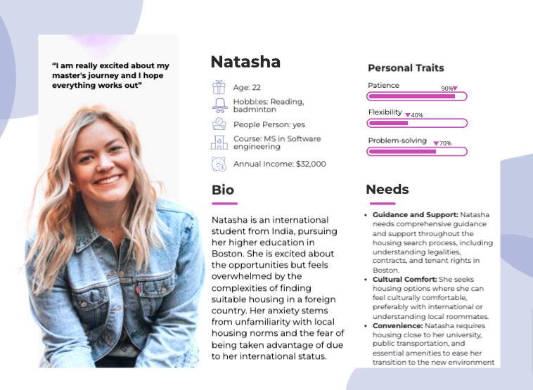

Persona 1
A Nervous Global Student
Pain Points:
Language Barrier: English is not Natasha's first language, making it challenging to comprehend intricate housing agreements and communicate effectively with landlords.
Financial Concerns: She is worried about hidden fees and deceptive pricing, fearing she might end up paying more than she can afford.
Safety Apprehensions: Being new to Boston, Natasha is concerned about the safety of neighborhoods and the reliability of online listings.

Slide 17
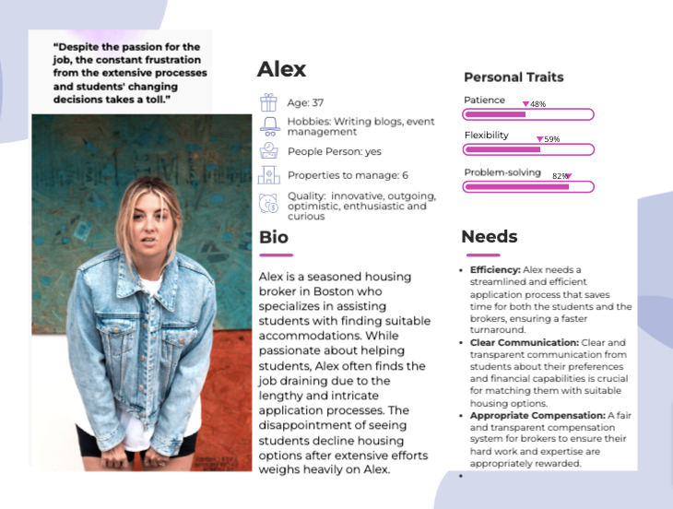
Persona 2
A Frustrated Broker
Pain Points:
Time-Consuming Process: Lengthy paperwork and convoluted application procedures lead to frustration when students reject housing options after investing significant time and effort.
Mismatched Expectations: Students often have unrealistic expectations, leading to disappointments when they realize the limitations of their budget and housing options.
Lack of Commitment: Some students express interest but back out at the last moment, leaving brokers with empty slots and wasted efforts.

Slide 18
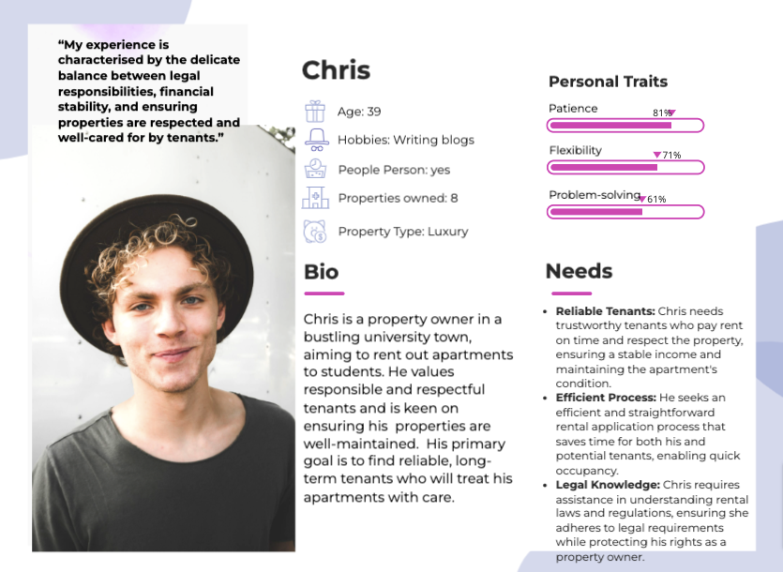
Persona 3
Busy Owner
Pain Points
Tenant Screening: Finding the right tenants amidst numerous applications is challenging. Screening applicants to ensure reliability is time-consuming and stressful.
Legal Complexities: Navigating the legal aspects of renting, including drafting contracts and understanding tenant rights, often feels overwhelming and confusing for Cristine.
Vacancy Concerns: Prolonged vacancies impact his income. He worries about timely rentals, especially during the academic year, to ensure a consistent revenue stream.

Slide 19
UX Research methods you applied for your project
Empathy Map: Purpose: Visualize user emotions, thoughts, and experiences to enhance understanding and design empathetic user interfaces.
SWOT Analysis Purpose: Evaluate internal Strengths and Weaknesses, external Opportunities and Threats to inform strategic decision-making.
Competitive Analysis: Purpose: Study competitors’ products, strategies, strengths, and weaknesses to identify market trends, user expectations, and areas for differentiation.

Slide 20
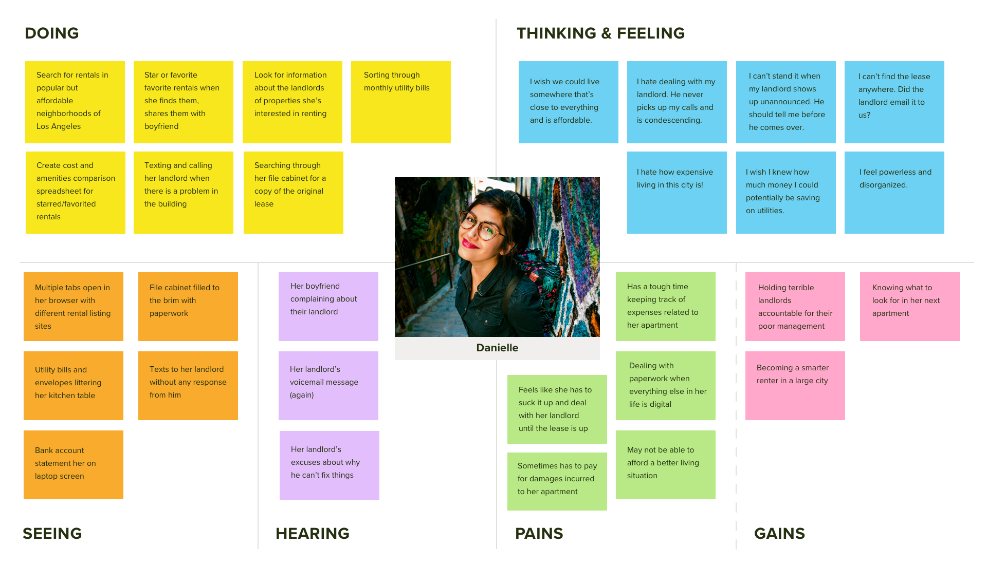
Empathy Map

Slide 21
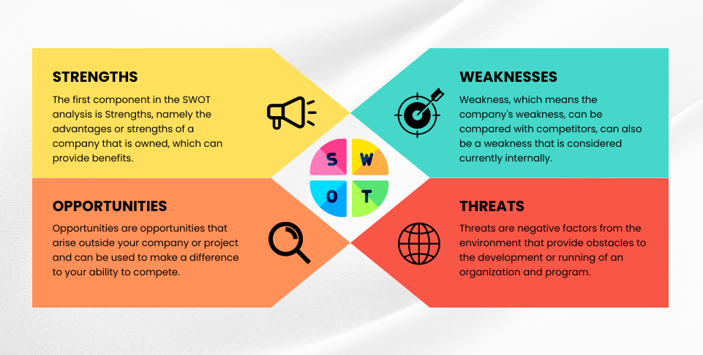
SWOT Analysis
SWOT analysis is a strategic planning tool used by businesses and organizations to assess their internal and external environments. The acronym "SWOT" stands for Strengths, Weaknesses, Opportunities, and Threats. Here's a breakdown of each component:

Slide 22
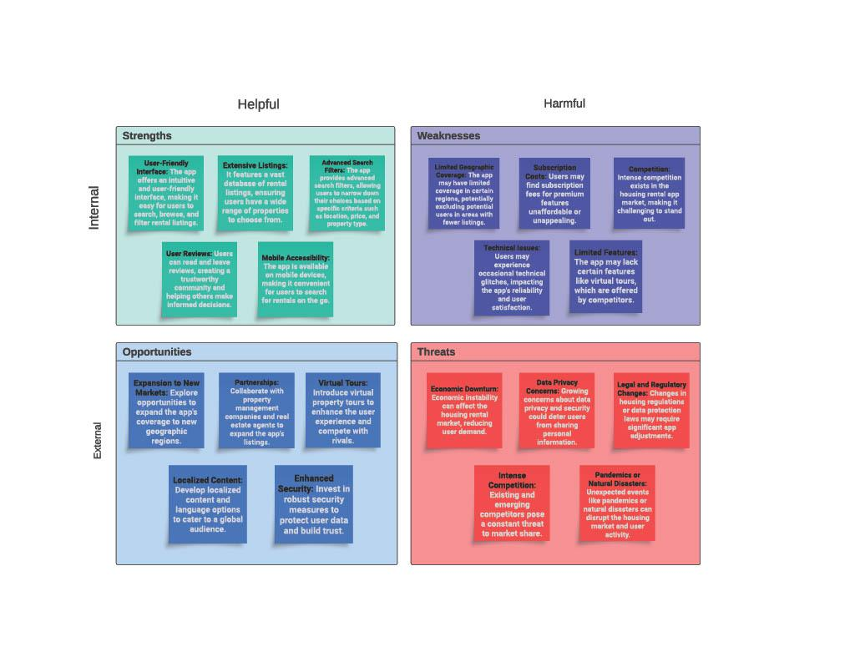

Slide 23
Competitive Analysis
Benchmarking:
Our rental app ratings are competitive, but user reviews mention a need for more property listings and enhanced brand recognition.
Our app has a well-established user base with high app ratings, but reviews occasionally mention a need for a more modern user interface.
Our app maintains a loyal customer base with positive reviews for its user-friendliness and customer support, but it faces challenges related to market reach and the size of its property database.
Market Trends:
Our app needs to stay updated on market trends, such as the demand for sustainable housing and emerging technologies like smart home integration, to remain competitive.
User Feedback and Reviews:
Monitoring user feedback is crucial for our app. Current feedback suggests a positive response to the innovative features and user interface but emphasizes the need for more property listings.
Competitive Advantage:
Our app's competitive advantage lies in its innovative features, including AI-driven recommendations and a modern design, which can set it apart from competitors.
Strategic Planning:
Our app should focus on increasing brand recognition and expanding its property database to remain competitive with RentalEase and HomeSeeker. Regularly seeking and implementing user feedback is essential for ongoing improvement.

Slide 24
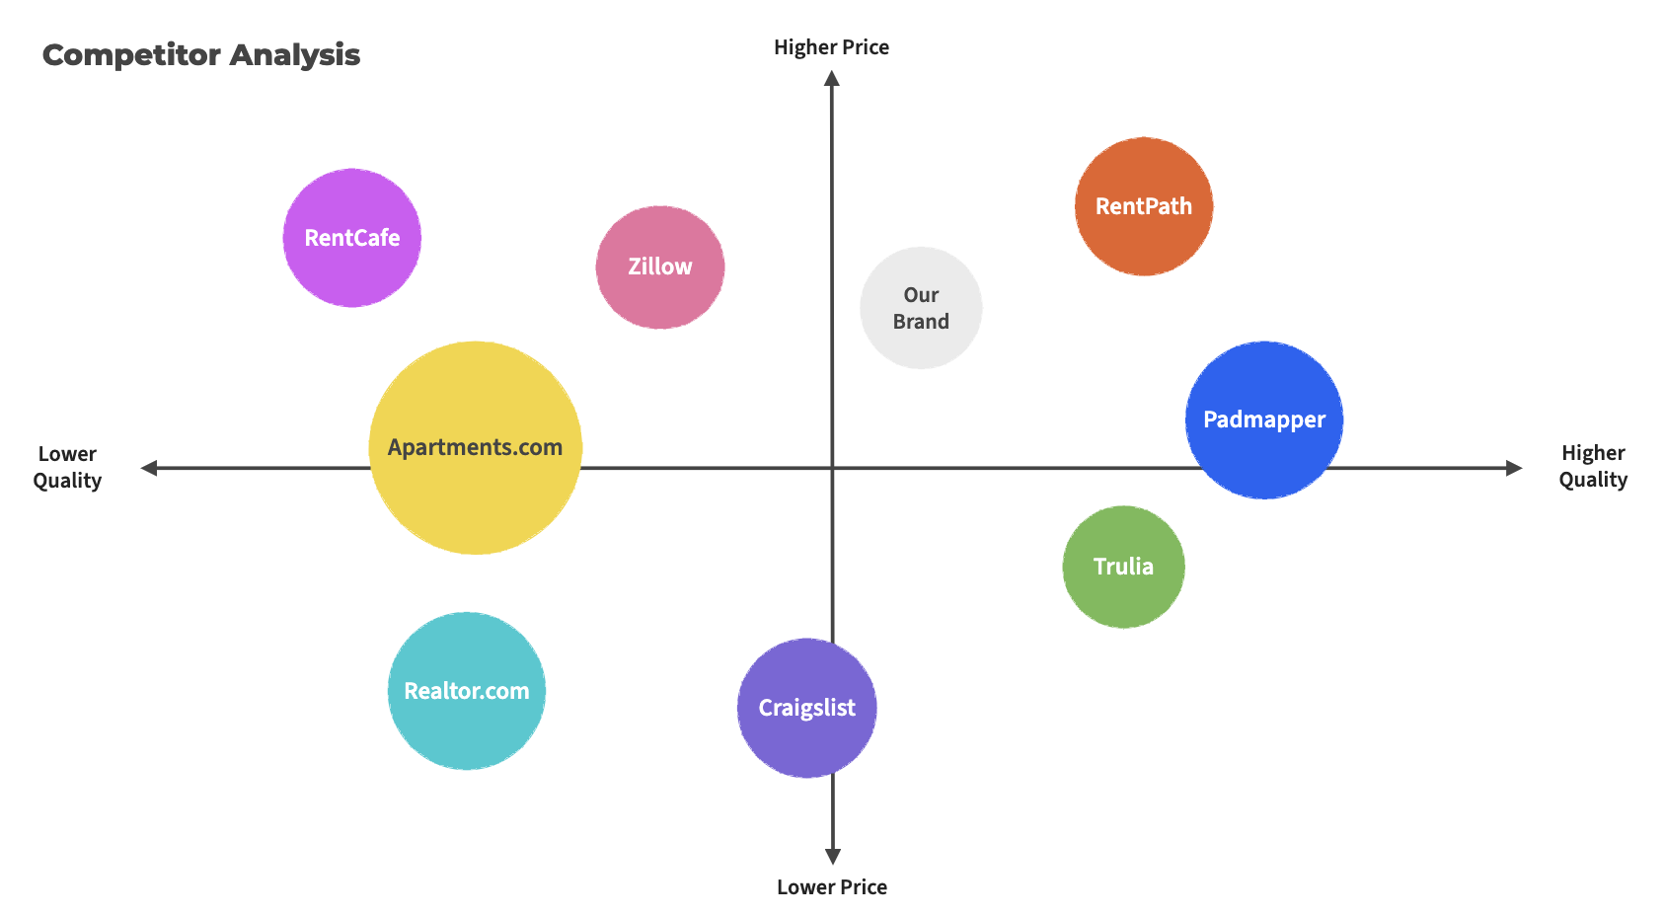

Slide 25
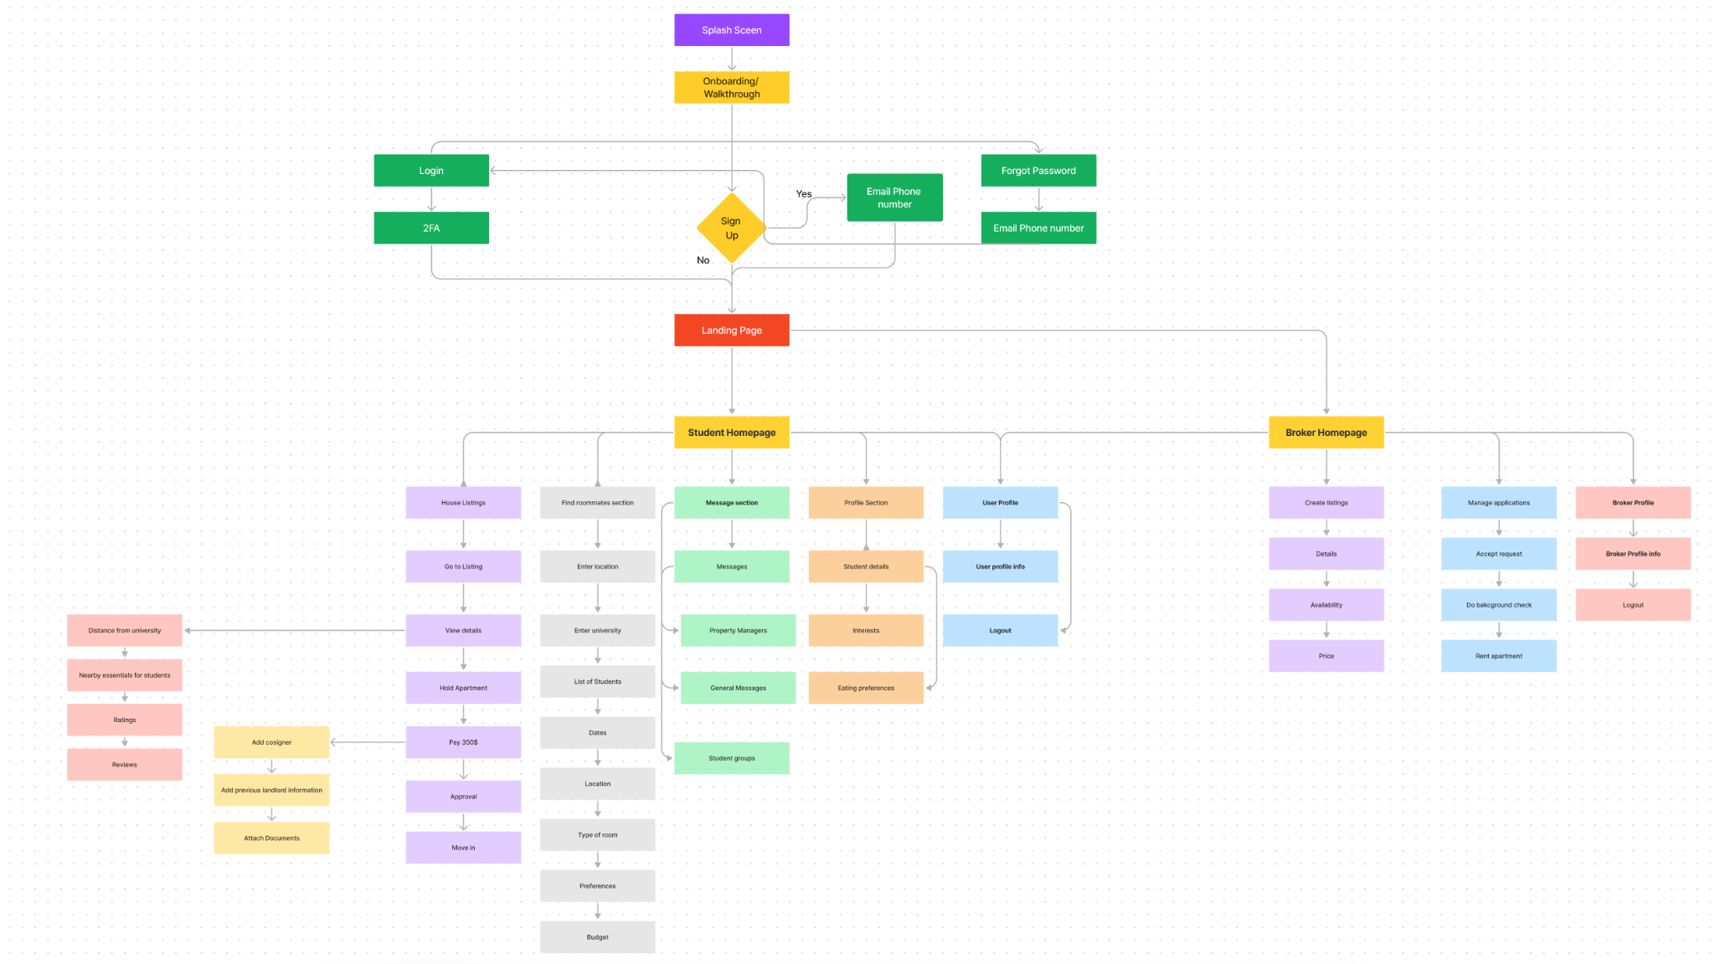
Information Architecture

Slide 26
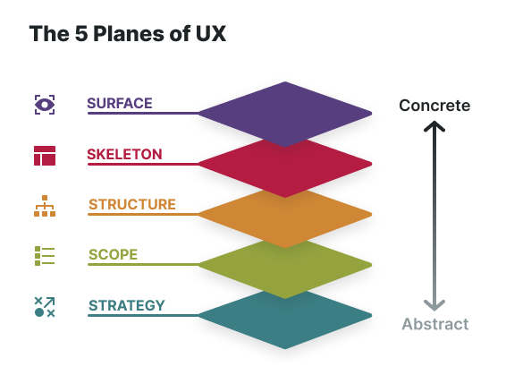
Surface Plane
Overview:
The surface plane deals with the logical arrangements that make up the website. This plane deals with the sensory design and presentation of the product.
The surface plane is constructed by the using of the five senses; hearing, vision, touch, smell and taste. The visual layout is an important structure to this plane.
The color palette, typography and design composite are important components to this plane. If the design is successful it will appeal to the user and visually be of interest.

Slide 27
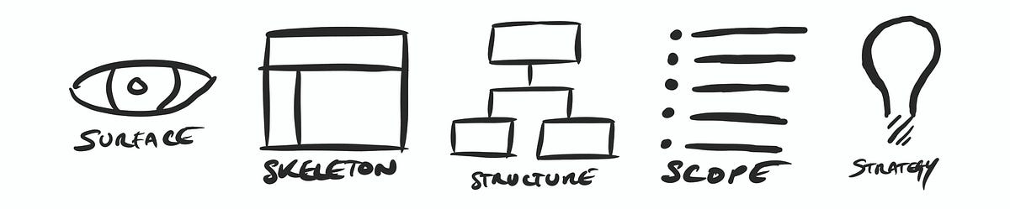
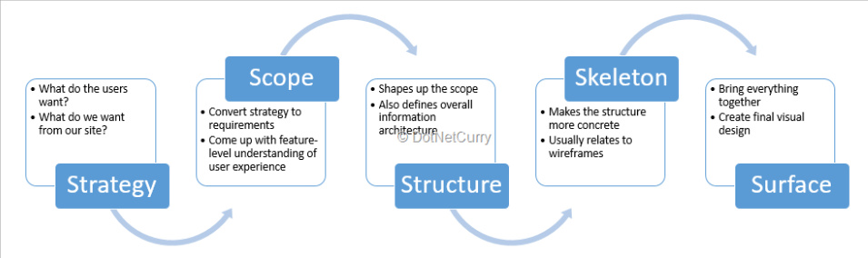
Surface Plane

Slide 28
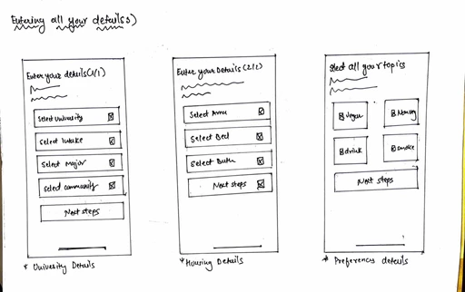
Wireframes

Slide 29
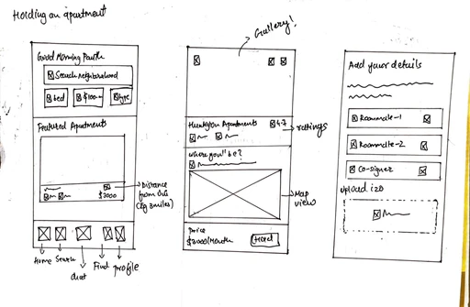
Wireframes

Slide 30
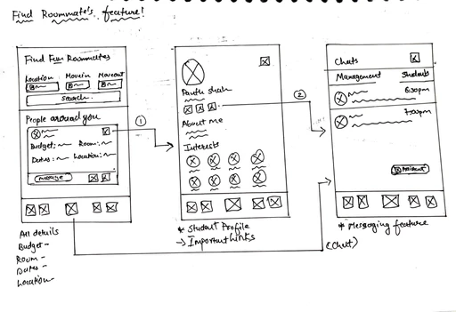
Wireframes

Slide 31
Plugins Used
Unsplash is a popular platform that provides high-quality, freely usable images, and many applications or platforms integrate with Unsplash to allow users to easily access and use these images.
Unsplash – –
Icons8 – –
Icons8 is a platform that provides a variety of design resources, including icons, photos, illustrations, and music. Icons8 offers a service that allows users to access a large collection of icons that can be used for design projects, presentations, websites, and more.
Weavely Forms is a Figma plugin that lets you design and publish working forms directly within Figma. It offers a wide range of features like conditional logic, data validation, and integration with Zapier. It's free to use and saves you time by eliminating coding.
Weavely Forms – –
Figmify – –
Bring your designs to life with animations and transitions, allowing you to prototype and preview interactions directly in Figma.

Slide 32
Conclusion
Addressing Student Housing Challenges: Developed a comprehensive app specifically designed for college students' unique housing needs.
Holistic Features: The app combines housing searches, localized insights, and roommate matching for an all-in-one solution.
In-depth Market Research: Conducted thorough research and drew comparisons with leading industry platforms.
User-Centric Approach: Developed user personas to drive design decisions and feature integrations.
Interactive Prototyping: Constructed a prototype to offer tangible insights and understand the user journey.
Usability Testing: Engaged with the target demographic for direct feedback, ensuring app's relevance and user satisfaction.
Holistic Development Strategy: Integrated research, analysis, design, and validation to position the app effectively for student housing needs.

Slide 33
References
RentalSearch, Inc. (2022). RentalSearch: A User-Centric Apartment Rental Application. Retrieved from https://www.rentalsearchapp.com
Smith, J. D. (2021). Innovations in Real Estate Technology: A Case Study of RentalSearch. Journal of Real Estate Technology, 12(3), 245-261.
Johnson, A. R., & Lee, S. (2020). Enhancing User Experience in Apartment Search Applications: Lessons from RentalSearch. In Proceedings of the International Conference on User Experience Design (UXD 2020), 112-126.
Anderson, M. (2019). Mobile App Development for Real Estate: A Focus on RentalSearch. Tech Trends, 42(4), 389-402.
RentalSearch, Inc. (2018). RentalSearch Analytics Report: Trends in Apartment Rental Applications. Retrieved from https://www.rentalsearchapp.com/analytics-report
Torre, D., & Lamata, M. T. (2016). A Review of Recommender Systems in the Real Estate Industry. MDPI. https://www.mdpi.com/2504-446X/1/1/17
Vasilev, A. Mobile Application Development for Real Estate Industry. https://www.intellectsoft.net/blog/mobile-application-development-for-real-estate-industry
Parker, L. M., & Williams, R. K. (2019). RentEasy: A Comparative Analysis of Apartment Search Applications. Journal of Real Estate Technology, 11(2), 187-204.
SmartLiving Technologies, Inc. (2020). SmartLiving Rentals: Revolutionizing Apartment Search. Retrieved from https://www.smartlivingrentals.com

Slide 34
Thank You!

